Slide 1

Chada Tech
CT
CHADA TECH
Scrum-Agile Framework

Slide 2

About Us
Chada Tech – a company that specializes in custom software design
Development for both domestic and international clients
Used waterfall development method for previous work
Considering moving from waterfall to agile methodology
Our team was used as a pilot for agile SNHU Travel Project

Slide 3
Scrum-Agile Team
Three primary roles
Product Owner
Scrum Master
The Product Owner is responsible for maximizing the value of the product and work of the development team.
Optimization and management of the product backlog
Optimizing the value of the work the Development Team performs
Ensuring that the Product Backlog is visible, transparent, and clear to all
The Scrum Master is responsible for ensuring Scrum is understood and enacted.
Helping the Scrum Team understand the need for clear and concise Product Backlog items
Understanding product planning in an empirical environment
Coaching the Development Team in self-organization and cross-functionality
Removing impediments to the Development Team’s progress

Slide 4
Scrum-Agile Team
Three primary roles
Development Team
The Development Team are structured and empowered by the organization to organize and manage their own work.
Self-organizing
Cross-functional
No titles other than Developer regardless of the work being performed by the person
No sub-teams
The team is expected to act as a single entity
A team can consist of people with different specialties
Each member of the team is expected to plan their activates and accountable for delivering the results

Slide 5
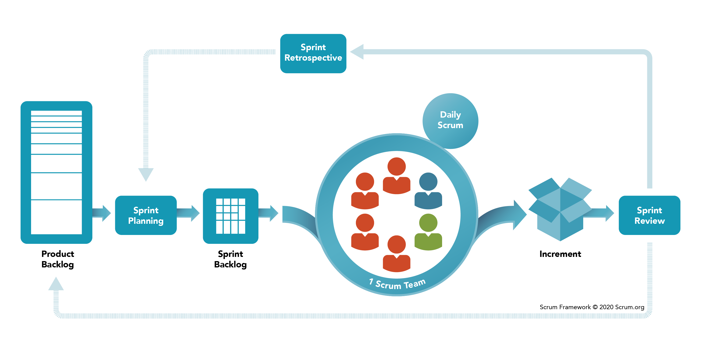
Scrum-Agile Framework

Slide 6
Scrum-Agile Framework
Product backlog is set up by the product owner with inputs from Customers, Team, Managers, and Execs
Sprint Planning Meeting – team selects starting at top as much as it can commit to deliver by end of Sprint
Sprint Backlog is setup to commence Task Breakout
Sprints are set up usually one to four weeks
Daily Standup meeting organized by the Scrum Master to help keep things moving along and updating the Sprint and Product Backlog
Once a partially finished product is “done” it will be shipped and then refactoring and updated

Slide 7
Traditional Waterfall Framework
The waterfall model describes a development method that is linear and sequential
Waterfall development has distinct goals for each phase of development
Plan-driven
Attempts to define and document detailed requirements and a plan for the entire project prior to starting the project
Agile framework is more flexible and fluid
Agile is Development team friendly
Agile picks people over processes

Slide 8
Thank You.
CT
Alexander Vera
CHADA TECH
9042009136
Alexander.vera@snhu.edu

